Slide 1
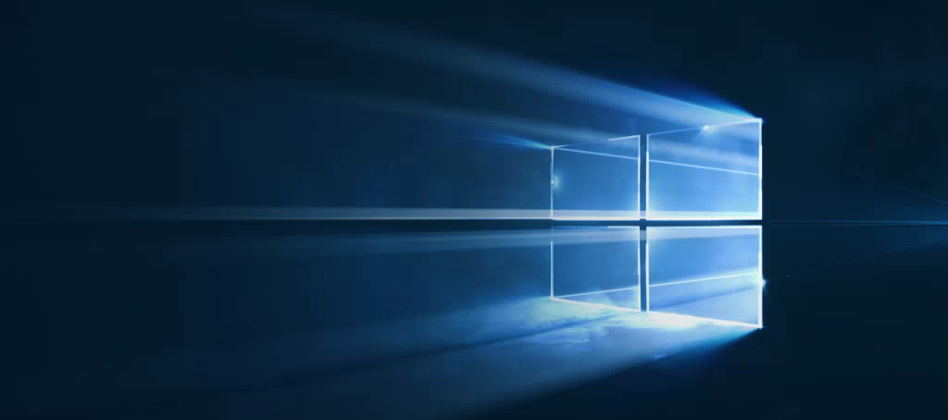
Windows
Camp //Labs
2015

Slide 2




Windows Camp //Labs
#wincamplabs

Slide 3
Введение в платформу универсальных приложений Windows 10
01
Дмитрий Сошников
Технологический евангелист, Microsoft
dmitryso@microsoft.com | vk.com/shwars

Slide 4

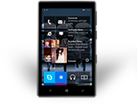
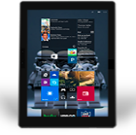
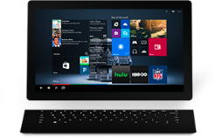
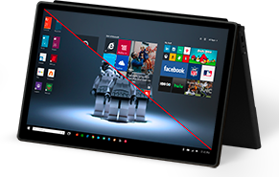
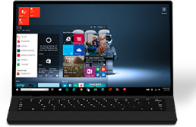
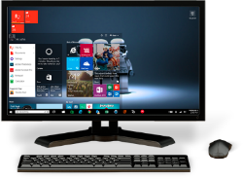
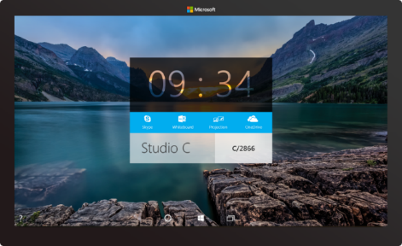

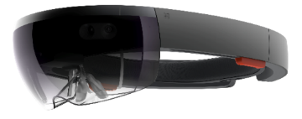
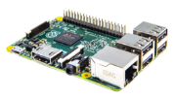
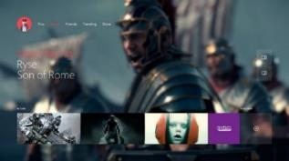

2-в-1 (планшет или лаптоп)
Ноутбук
Настольный ПК или всё-в-одном
Смартфон
Фаблет
Планшет
Бoльшой планшет
Windows 10
Surface Hub
Xbox
Hololens
IoT
Notes:
Windows 10 runs on a wide variety of devices, from phones with a 4.5” screen, through phablets, tablets, PCs, laptops, convertibles such as the Surface, on desktops and All-in-ones, to the Xbox in your living room and right up to giant 84” screens such as our team collaboration device, the Surface Hub. And it also takes in very tiny cheap computers such as the Raspberry Pi 2, and innovative hardware such as the Hololens.

Slide 5

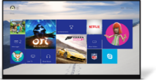
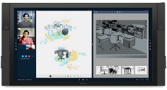

















PC
XBox
Mobile
Surface Hub
Devices +IoT
Различные семейства устройств
HoloLens
Универсальные приложения
Адаптивный интерфейс
Переисполь-зование кода
Естественное взаимодей-ствие
Один магазин+ и центр разработчика
Одно SDK + Инструменты
Одна универсальная платоформа Windows
Notes:
We’ve divided this broad range of hardware into different device families – as developers you will likely build apps that target one or more device families.
<click>
We have small devices and IoT, phones and small tablets are in the Mobile device family, large tablets and PCs in the PC (or as we more usually call it, Desktop) family, the Xbox, Surface Hub (or ‘Team’) and finally the Hololens
<click>
And all of these device families run the same developer platform – the Universal Windows Platform. You can build a single app that can run across all these device families using a single SDK and distribute apps through a single store.
Of course, with this diversity of devices, what we are *not* saying is that you should create one app that kind of works adequately across all these devices. No, we want you to create apps that shine on each device family, so we’ve added APIs, controls and tools to help you build an adaptive UI.

Slide 6
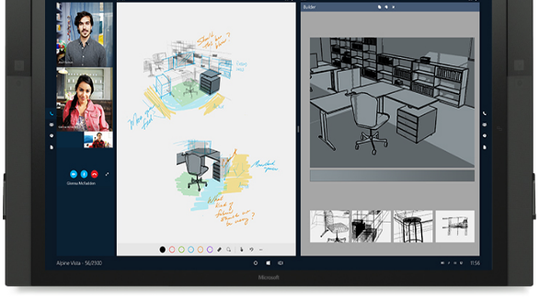
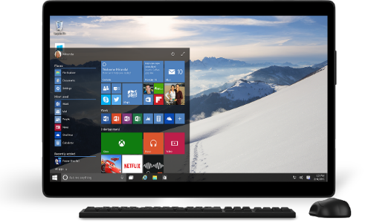
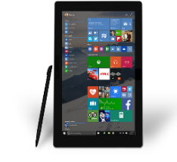
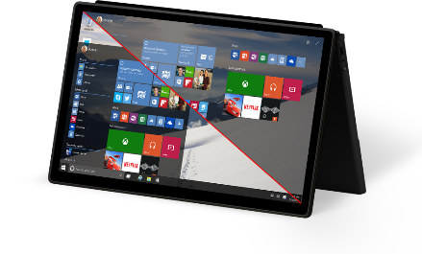
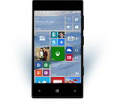

Универсальная платформа Windows
Одна операционная система
Единое ядро для всех устройств
Одна платформа приложений
Приложения работают на всех семействах устройств
Один центр разработчика
Достаточно один раз подать приложение в магазин
Один магазин
Глобальная доступность, локальная монетизация Потребители, компании и образование
Notes:
Windows 10 offers an unprecedented opportunity for developers: the same core operating system across all Windows 10 devices, a common app platform, a single dev center where the developer can manage their app submissions for all Windows 10 devices, and a single Windows Store for app deployment, including special access for Businesses and Education.

Slide 7
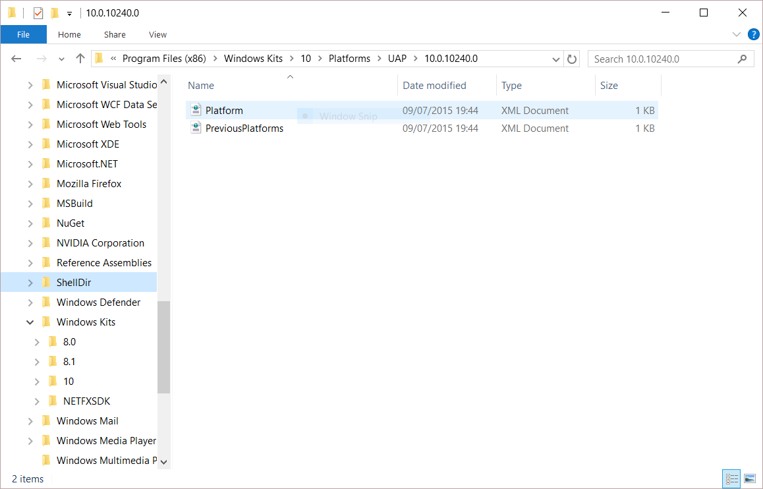
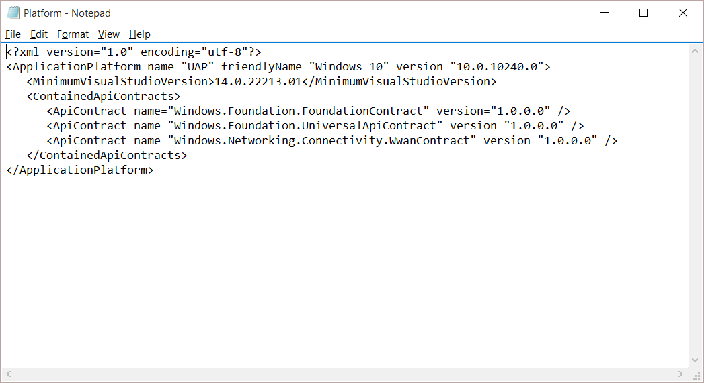
Универсальная платформа Windows
Единый гарантированный контракт API
Одинаковый на всех устройствах
Universal Windows Platform
Windows Core
Desktop
Device
Phone
Device
Xbox
Device
Notes:
So, what is the Universal Windows Platform?
It’s a single API surface that is consistent across all Windows 10 devices.
This guaranteed API surface is what enables developers to build a single app that can run across all devices.
What we’ve done is taken the Windows Runtime APIs that we first launched with Windows 8, massively expanded it and we’ve also componentized it, dividing it into a number of ‘contracts’.
Why ‘contract’? – Because these components provide a contract between the platform and you, the developer, that a certain major version of a contract will offer a guaranteed API surface and behaviors, even through many minor revisions. It allows us to innovate and enhance the platform by releasing updated components exposing new capabilities and allows you to develop apps against a versioned API.

Slide 8
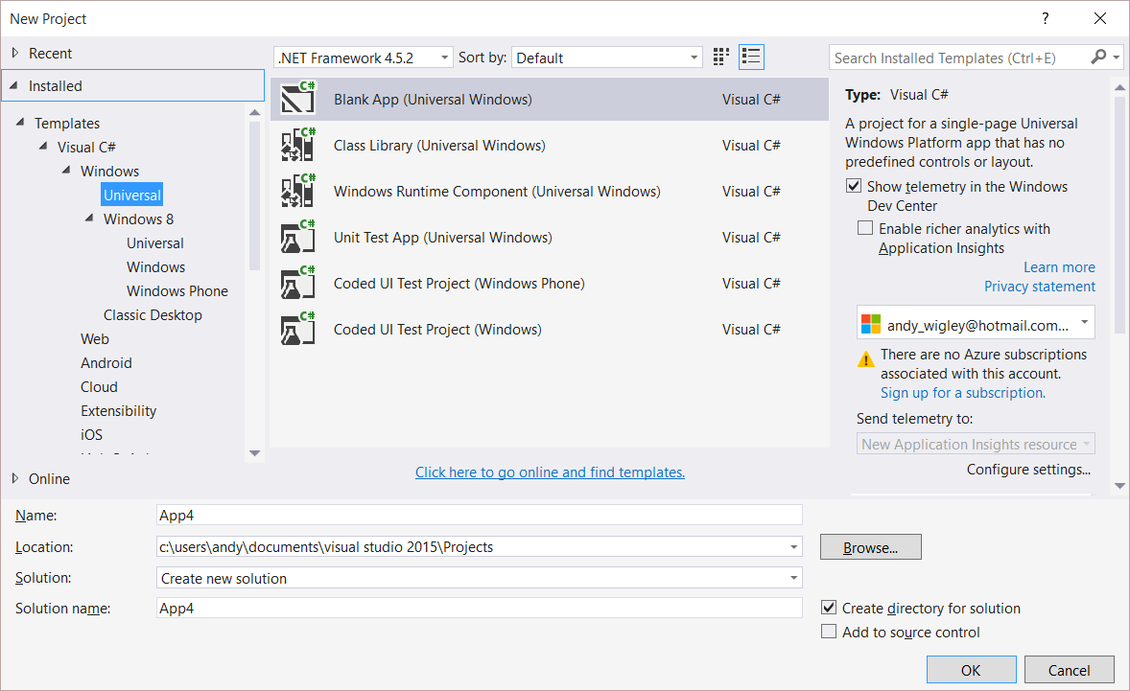
Универсальные приложения Windows
Единый пакет приложения
Работает на любом устройстве
Может проверять доступность возможностей
Подстраивается под устройство
Windows App
Universal Windows Platform
Windows Core
Desktop
Device
Phone
Device
Xbox
Device
Notes:
So, on top of the UWP, you build your universal Windows app.
Unlike in Windows 8.1, where a universal 8.1 app creates separate binaries for PC and for Phone, with UWP it truly is a single app package that can run on any UWP device.
The runtime on each device family is able to run UWP apps whatever the device.

Slide 9
Lab 1A: Hello UWP World
Дмитрий Сошников
технологический евангелист, Майкрософт

Slide 10
Навигация в приложениях

Slide 11
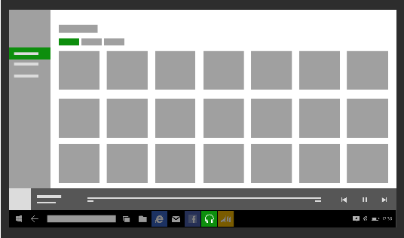
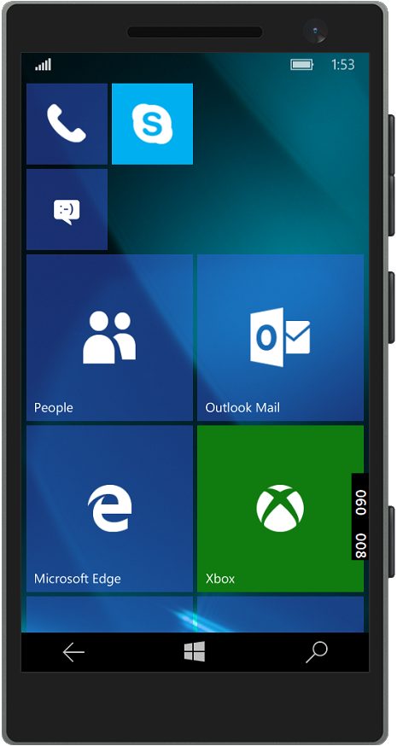
Мобильные и планшеты: стандартная кнопка

Slide 12
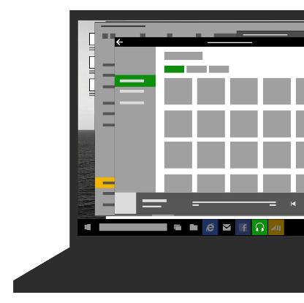

Рабочий стол к оконном режиме: Опциональная кнопка на панели заголовка
if (Frame.CanGoBack)
{
// Setting this visible is ignored on Mobile and when in tablet mode! Windows.UI.Core.SystemNavigationManager.GetForCurrentView().AppViewBackButtonVisibility = AppViewBackButtonVisibility.Visible;
}

Slide 13

Десктоп в оконном режиме: Кнопка, отображаемая самим приложением

Slide 14
Lab 1B: Навигация и обработка возврата
Дмитрий Сошников
технологический евангелист, Майкрософт

